Slide 1
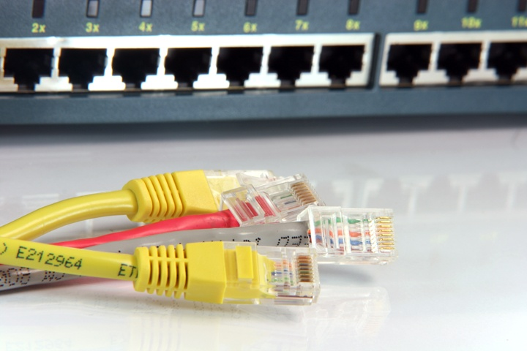
Lecture
0
Computer and Communication
Networks

Slide 2
Why study Computer and Communication Networks ?
A group or system of interconnected people or things.
Notes:
I would first like to cover and clarify the concept of “Communication” used in Communication Networks. Later, I shall cover the concept of “Networks or Networking” i.e. how computers communicate with each other when they are networked or form a network ……..it depends on the medium which can either be wired medium or can wireless medium [something that is related to Physical layer of the TCP/IP model which we will cover during the initial stages of this course]. Therefore, A network can-not be formed without using any medium so as the title which is a collective combination of both Computer Networks and Communications Networks. You will understand this as soon as we go deeply into the course.

Slide 3
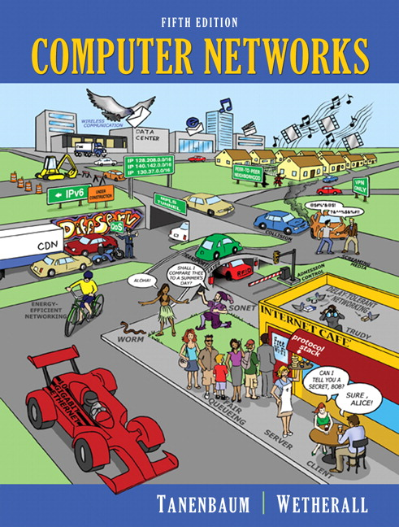
Course textbook
“Computers Networks”,
Tanenbaum and Wetherall,
5th edition.

Slide 4


Reference books
Disclaimer: I shall be copying slides, figures, and different material for Lecture presentation from Dr. Junaid Qadir Slides, Online slides available for the below mentioned books by the authors of the book. For this I am thankful to Dr. Junaid and the authors for putting some nice slides over the internet.
[Kurose & Ross]
[Peterson & Davie]
Notes:
And other online material which will be referred during the lectures time to time……

Slide 5
Course Contents
Notes:
In this course we will follow the bottom to top approach for both Computer Networks and Communications Networks.

Slide 6
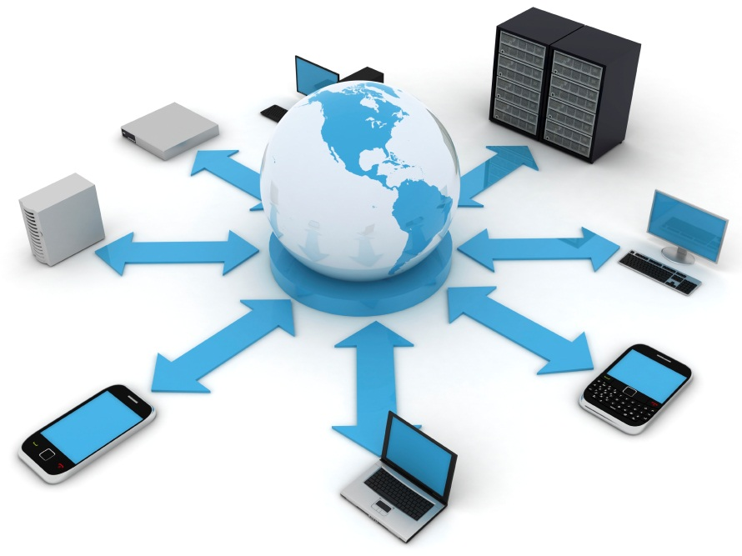
Topic 0
Introduction to this course
and to networks

Slide 7
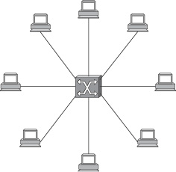
Topic 1
Physical layer technologies:
Notes:
We will start with the Physical layer of the TCP/IP Protocol stack.

Slide 8
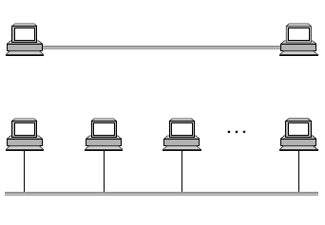
Topic 2
How do nodes connect over a single direct link to form a network?
Notes:
MAC layer: Medium Access Control. For Wired Networks, MAC layer assigns hardware addresses which is also called the Physical address of the computer. It’s a 48 bit address. However, when it comes to Wireless Communication then it serves the true meaning of its name “Medium” “Access” “Control”: Fair access of the medium which is shared among various users. The same thing can also happen when various computers are sharing common wire in networked computers and MAC layer device is used to resolve the issues among various Computers to get the access to the medium.

Slide 9
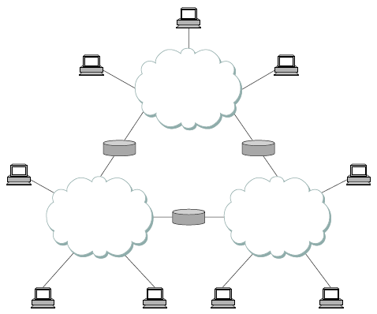
Topic 3
How heterogeneous networks
are connected to form internets?
Net1
Net 2
Net3
Notes:
Network Layer: Routing: How to route a packet from the source to the destination.

Slide 10
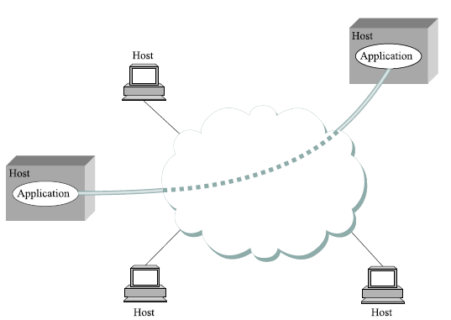
Topic 4
How processes on different nodes communicate over an internetwork?
Notes:
Reliably or Unreliably…….Transport Layer……TCP and UDP

Slide 11
Topic 5
How various applications
interact over an internetwork?
HTTP
SSH
POP
DNS
IMAP
SIP
FTP
RTP
TELNET
SMTP
Notes:
Applications which you guys are much more familiar because everyone now uses a Computer in some shape of a form whether it is a Desktop or your mobile phone which also has lot of applications.
For accessing internet HTTP is the most common application which everyone uses to get an access to the internet (www) and we shall cover a short example to clarify the concept in this week.

Slide 12
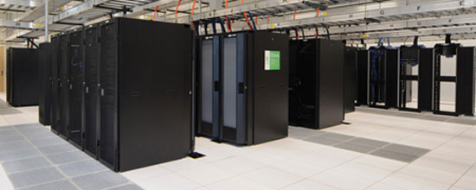
Topic 6
Modern networking trends
Other Related Advanced Topics
Notes:
SDN: Software Defined Networking

Slide 13
A Brief History of Internet
The history of the Internet begins with the development of electronic computers in the 1950s.
Initial concepts of wide area networking originated in several computer science laboratories in the United States, United Kingdom, and France.
The US Department of Defense awarded contracts as early as the 1960s, including for the development of the ARPANET project.
The first message was sent over the ARPANET in 1969 from computer science laboratory at University of California, Los Angeles (UCLA) to the second network node at Stanford Research Institute (SRI).
Modern networking trends
https://www.internetsociety.org/internet/history-internet/brief-history-internet/

Slide 14
Networking
‘‘
Networks is a set of technologies – including hardware, software and media – that can be used to connect computers together, enabling them to communicate, exchange information and share resources in real time
[Peter Norton]
’’
Notes:
and data; provide better communications; help to secure information; and provide access to numerous databases. Types of networks are as follows. A wide area network (WAN) covers a wide geographical area, such as a country. A metropolitan area network (MAN) covers a city or suburb. A local area network (LAN) covers a limited area such as an office or a building. Most large networks have a host computer, a mainframe or midsize central computer to control the network. Any device attached to a network is called a node. MANs and LANs may be connected to the internet by a high-speed network called a backbone. Two types of LANs are client/server and peer-to-peer. A client/server LAN consists of microcomputers that request data (clients) and powerful computers that provide data (servers). A file server, for example, stores programs and data files; other servers are database server, print server, web server, and mail server. In a peer-to-peer LAN, there is no server; microcomputers on a network communicate with each other directly. Several standard components of a LAN are the connection or the cabling system, microcomputers with network interface cards (NIC), network operating system (Novel NetWare, Microsoft Windows NT/2000, Unix, or Linux), and other shared devices (printers, storage devices). Other components are a router, a special computer that helps to communicate messages when networks are tied together; a bridge, an interface used to connect the same types of networks; a gateway, an interface that allows communication between dissimilar networks; and a hub, a common connection point for devices in a network.

Slide 15
Benefits
Resource sharing (cost savings)
Personal communication
Data backups
Reliability (reduced errors/inconsistencies)
Greater performance (distributed computing)
Personalized/ contextualized services
Notes:
Why they are interesting?
Overcome geographic limits
Access remote data
Separate clients and server
Reliability: Reduce errors and inconsistencies
Greater performance: Grid computing; Distributed computing

Slide 16
Network
Design Issues
Media; Topology; Protocol;
Addressing; Naming;

Slide 17
Network Topology
Network topology is the study of the physical (real) and logical (virtual) interconnections between nodes [Wikipedia]
Topology types:
Point to Point; Bus; Star; Ring; Mesh and Hybrid
Notes:
Factors Affecting How Data is Transmitted. Several factors affect how data is transmitted. (1) Line configurations are the methods whereby communications lines are connected. A point-to-point line directly connects the sending and receiving devices, whereas a multipoint line is a single line that interconnects several communications devices to one computer. (2) Serial transmission transmits the bits sequentially; parallel data transmission transmits bits through separate lines simultaneously. (3) Data can flow in three ways: simplex (one way); half-duplex (in both directions but not at the same time); and full-duplex (in both directions simultaneously). (4) The transmission mode can be either asynchronous or synchronous. In asynchronous transmission, data is sent one byte at a time, with a "start" bit and a "stop" bit. With synchronous transmission, data is transmitted in blocks, with a start and a stop bit pattern to delineate each block. (5) In circuit switching, the transmitter has full use of the circuit until all the data has been transmitted and the circuit is terminated. In packet switching, electronic messages are divided into packets for transmission over a wide area network to their destination, through the most expedient route. (6) The efficiency of data transmission can be increased by transmitting multiple signals over a single communications channel, a process known as multiplexing. Multiplexing devices include multiplexers, concentrators, and front-end processors. (7) A protocol is a set of conventions that control the exchange of data between hardware and/or software components in a communications network. (8) OSI is an international standard that defines seven layers of protocols for worldwide computer communications.

Slide 18
Network Topology (cont)
Point to Point
Bus
Star
Fully Connected
Tree
Partial Mesh
Ring
Notes:
Point-to-point (PTP) topology connects two nodes directly together. The following examples are pure point to point links:
Two computers communicating via modems.
A mainframe terminal communicating with a front end processor.
A workstation communicating along a parallel cable to a printer.
http://www.dcs.napier.ac.uk/~bill/cisco_presentation/brian.ppt

Slide 19
Protocol
‘‘
The rules governing the syntax, semantics, and synchronization of communication. [Wikipedia]
’’
Protocol defines 1) format and 2) order of messages sent and received among network entities and 3) action(s) taken on transmission and receipt of message
[Kurose and Ross]
‘‘
’’
Notes:
7) A protocol is a set of conventions that control the exchange of data between hardware and/or software components in a communications network. (8) OSI is an international standard that defines seven layers of protocols for worldwide computer communications.

Slide 20
Protocol
In this course, we will focus on protocols for data traffic only.
TCP/IP is the most dominant suite of protocols and is used on the Internet.
TCP/IP suite of protocols is often organized in a hierarchy of layers
Some other protocol suites (no where as popular) include: NetBIOS/ NetBEUI and IPX/ SPX.
Notes:
Net Basic Input output Systems used with TCP/IP
Internetwork Packet exchange (IPX)

Slide 21
Introduction to the Protocol Stack
stack: [m-w.org]
1: a large usually conical pile (as of hay, straw, or grain in the sheaf) left standing in the field for storage
2 a: an orderly pile or heap

Slide 22
Layered Architecture
Network protocol stacks (e.g., TCP/IP, OSI) are divided into distinct and ordered layers
Each layer has a very fixed interface with other layers, although complex services are implemented inside a layer
Why the layered approach?

Slide 23
Layered Architecture
Why the layered approach?
Advantages of the Layered Approach
Encapsulation of Complexity: only the pertinent, simple interface is visible to other layers
Fixed services offered via interface/s

Slide 24
An Example of a Non-Layered Communication
Consider a BigbossX of company SEECSTech who wants to send a very important letter to BigbossY who works at EMETech. One way of sending this letter is:
BigbossX types and prints the letter
Finds the address of BigbossY
Get directions to BigbossY’s address at EME
Drives to EME and gives the letter to BigbossY
Gets a verbal or written confirmation from BigbossY

Slide 25
An Example of a Non-Layered Communication
This approach leads to a lot of overhead work, which is not a part BigbossX’s job
What if:
BigbossY’s address is changed
BigbossY does not understand BigbossX’s language
BigbossY is not in his office when BigbossX comes to deliver the letter
BigbossY handles all of his communication through email or fax, not snailmail

Slide 26

An Example of a Non-Layered Communication
A better way of approaching this problem is:
BigbossX
BigbossY
SEECSTech Secretary
EMETech Secretary
mailman

Slide 27
The TCP/IP Protocol Stack
Application Layer
SMTP, POP3, FTP, HTTP…
Transport Layer
TCP and UDP
Network Layer
IP
Medium Access Control Layer
Ethernet, 802.11,…
Physical Layer
UTP, Fiber, Wireless…

Slide 28
The TCP/IP Protocol Stack
Application Layer
SMTP, POP3, FTP, HTTP…
payload
Transport Layer
TCP and UDP
trans
hdr
payload
Network Layer
IP
net
hdr
trans
hdr
payload
Medium Access Control Layer
Ethernet, 802.11,…
mac
hdr
net
hdr
trans
hdr
payload
Physical Layer
UTP, Fiber, Wireless…
phy
hdr
mac
hdr
net
hdr
trans
hdr
payload
Channel

Slide 29
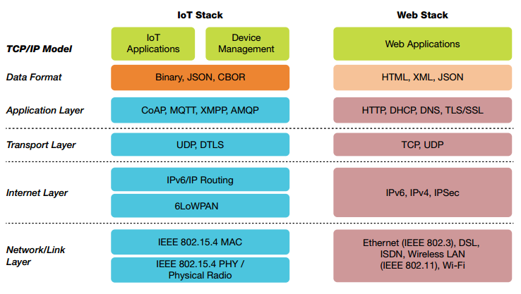
TCP/IP stack in IoTs
Notes:
Datagram Transport Layer Security
Constrained Application Protocol
Message Queue Telemetry Transport
Concise Binary Object Representation
Efficient XML Interchange
One of the disadvantages of TCP/IP is that it is not adaptable to new technologies and as a result we can say that it is not generic in nature. Example can be seen in the above slide where for IoT stack developers have defined/implemented their own protocols for various IoT applications.

Slide 30
OSI Protocol Stack
A framework is helpful in the design of hardware and software for communication
ISO-OSI Model serves this purpose
ISO (International Standard Organization)-OSI (Open System Interconnect)
Notes:
OSI- open systems interconnection

Slide 31
OSI Layered Architecture
There are seven layers in the model, hence the name the 7-Layer model
The model acts as a frame of reference in the design of communications and networking products. However, in this course we will use TCP/IP 5 Layer model which is used widely in the World.

Slide 32
Layered Communication
TCP/IP model
Application layer
GET / HTML/1.1
Source Port | Destination Port
> 1024 | 80
Payload
Transport layer
Payload
Internet layer
Source IP | Destination IP
202.125.157.150 | 202.125.157.196
Payload
Payload
Link layer
Source MAC address | Destination MAC address 23:34:aa:bb:cc:dd | 12:34:aa:bb:cc:dd
Payload
FCS
Notes:
There’s another layering model that’s called OSI model; we will not cover it in this course. However, you should know that it exists. You will study more about it in your computer networking course sometime in your last year.
OSI very successful at shaping thought. TCP/IP standard, however, has been practically more successful since it’s not based on the rigid OSI model

Slide 33
Networking devices
(same LAN)
Application
Application
Transport
Transport
Network
Network
Data Link
Data Link
Bits
Bits
Destination Host
(Same LAN)
Bridges/
Switches
Source Host
Repeater/
Hub
Device used in a single LAN: hub, bridge, switch
Notes:
There’s another layering model that’s called OSI model; we will not cover it in this course. However, you should know that it exists. You will study more about it in your computer networking course sometime in your last year.
OSI very successful at shaping thought. TCP/IP standard, however, has been practically more successful since it’s not based on the rigid OSI model

Slide 34
Internetworking devices
(different LAN)
Application
Application
Routers/
Gateway
Transport
Transport
Network
Network
Data Link
Data Link
Bits
Bits
Source Host
Destination Host
(Different network)
Notes:
Explain hubs/ switches/ routers through animations:
In a hub: a frame is received; it is copied on all other ports; it’s called a physical layer device. Show a frame being copied on all ports.
Motivate the question? Why copy on all ports, when you can just copy to the port the destination MAC is in? This can improve throughput as it will reduce some collisions and enable simultaneous transmissions.
In a switch, the frame is copied to the port destination MAC is connected to; how are the MAC addresses learnt?
A router is used to connect different LANs; An example?

Slide 35
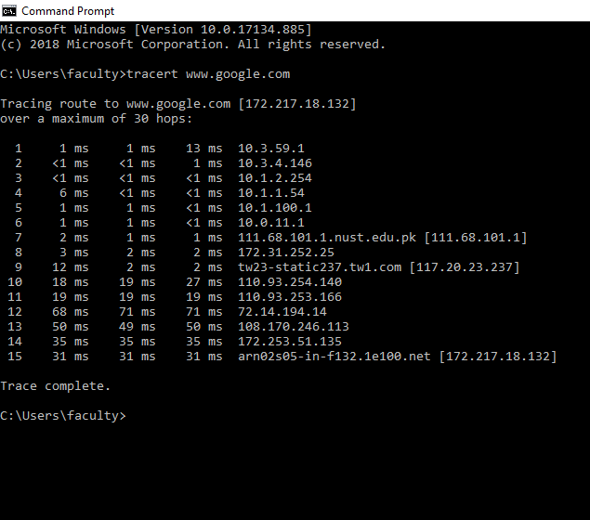
Routing example
Notes:
Courtesy: www.layertwo.net
www.tcpipguide.com

Slide 36
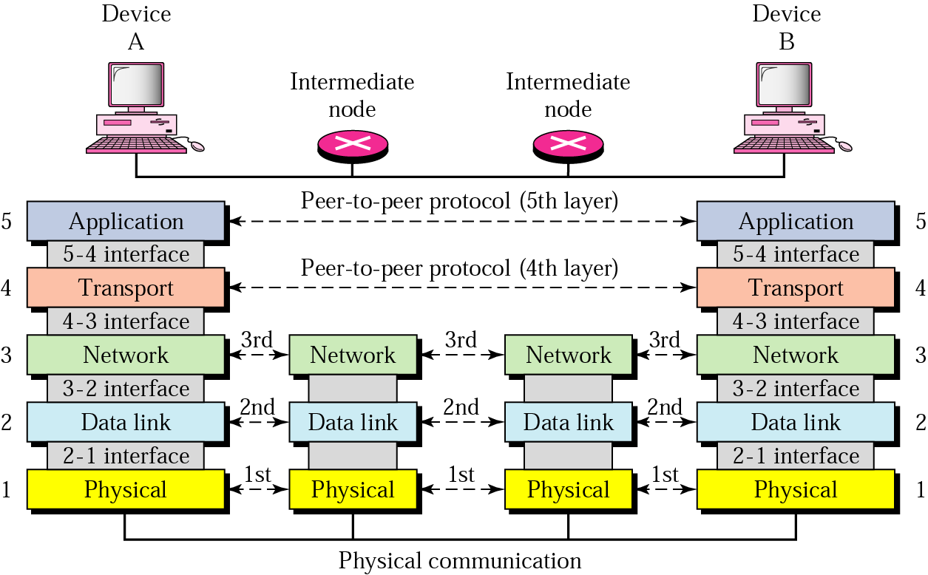
Layers communicate to corresponding layers

Slide 37
User sends email
Application layer
SMTP data
Source Port | Destination Port
> 1024 | 25
Payload
Transport layer
Payload
Internet layer
Source IP | Destination IP
202.125.157.150 | 115.186.131.69
Payload
Payload
Link layer
Source MAC address | Destination MAC address 23:34:aa:bb:cc:dd | 12:34:aa:bb:cc:dd
Payload
FCS

Slide 38
User receives email
Application layer
POP request
or IMAP request
or HTTP request
or IMAP request
or HTTP request
Source Port | Destination Port
> 1024 | 110 (POP)
Source Port | Destination Port
> 1024 | 143 ( if IMAP)
Source Port | Destination Port
> 1024 | 80 ( if HTTP)
Payload
Transport layer
Payload
Internet layer
Source IP | Destination IP
202.125.157.150 | 115.186.131.69
Payload
Payload
Link layer
Source MAC address | Destination MAC address 23:34:aa:bb:cc:dd | 12:34:aa:bb:cc:dd
Payload
FCS

Slide 39
Classification of Networks
2
Scope
Type
Paradigm
Hierarchy

Slide 40
Classification
(Geographical Scope)
Wide Area Networks
Metropolitan Area Networks
Campus Area Networks
Home Area Networks
Personal Area Networks
Decreasing
Scope

Slide 41
Brief Overview of Contemporary Networks
Infrastructure Wireless Networks
Mobile Ad Hoc Networks
Wireless Sensor Networks
Cellular Networks
Broadband Wireless Networks
Short-range Wireless Networks
Notes:
Institute of Electrical and Electronics Engineers

Slide 42
Infrastructure Wired/Wireless Networks: 802.1-21
local area network [m-w.org]
: a network of personal computers in a small area (as an office) for sharing resources (as a printer) or exchanging data
Ethernet is the most widely installed local area network (LAN) technology. Ethernet is a link layer protocol in the TCP/IP stack, describing how networked devices can format data for transmission to other network devices on the same network segment, and how to put that data out on the network connection

Slide 43
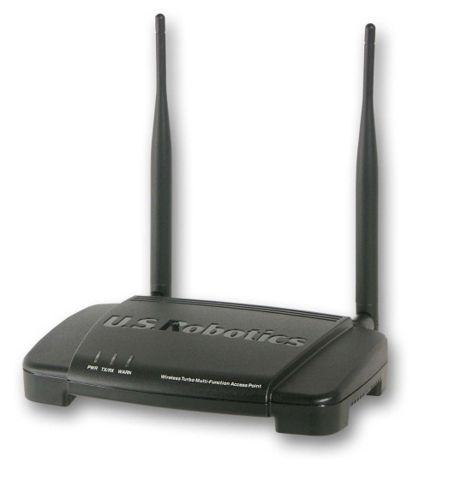
Infrastructure Wireless Networks: 802.11 LANs
In the infrastructure mode, 802.11 LANs have a central node called an access point (AP)
The AP is a relatively high-end node that acts as an arbitrator and a relay for other (potentially resource-constrained) nodes
All nodes on the network are required to register (associate) with the AP
All nodes’ traffic is routed through the AP
For Internet connectivity, the AP has a wired backend

Slide 44
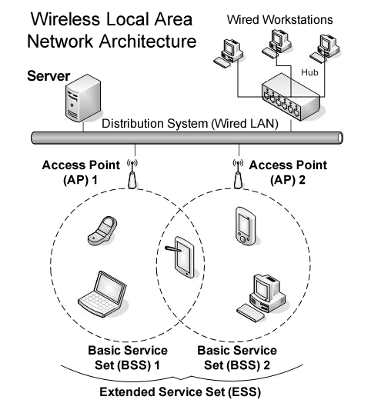
Infrastructure Wireless Networks: 802.11 LANs
Image courtesy of Wikipedia

Slide 45
Infrastructure Wireless Networks: 802.11 LANs
802.11 standards define the protocols for MAC and physical layers
The MAC layer is CSMA/CA based and is common to most 802.11 networks
Physical layer is different for each 802.11 variant
Four famous physical layers are:
802.11b
802.11a
802.11g
802.11n

Slide 46
Infrastructure Wireless Networks: 802.11 LANs
In current deployments, the standard TCP/IP protocol stack is used on top of 802.11 physical and MAC layers
Application
TCP/UDP
IP
802.11 MAC
Physical Layer
802.11a/b/g/e/n…

Slide 47
Infrastructure Wireless Networks: 802.11b
Ratified in 1999
Operates at 2.4 GHz
Multiple Data rates: 1, 2, 5.5, 11 Mbps
Data rate is selected and changed according to the variations in signal quality
Range: ~35m indoor, ~100m outdoor

Slide 48
Infrastructure Wireless Networks: 802.11a
Ratified in 1999
Operates at 5 GHz
Multiple Data rates: 54, 48, 36, 24, 18, 12, 9 and 6 Mbps
Best operation with line-of-sight
Range: ~25m indoor, ~75m outdoor

Slide 49
Infrastructure Wireless Networks: 802.11n
Ratified in January 2007
Uses Multiple-Input-Multiple-Output (MIMO) technology
Can operate at both 2 GHz and 5 GHz
576 possible data rates: Max. 540 Mbps
Range: ~50m indoor, ~125m outdoor

Slide 50
Mobile Ad Hoc Networks
The fundamental design constraint is mobility
A secondary yet very important design constraint is energy efficiency
The 802.11 physical and MAC layers are used with slight modification, and many mobility-aware transport and network layers have been proposed

Slide 51
Wireless Sensor Networks
Ratified in May 2003 as IEEE 802.15.4
Can operate at 2.4 GHz, 915 MHz and 868 MHz
Data rates: 250 Kbps @ 2.4 GHz, 40 Kbps @ 915 MHz, 20 Kbps @ 868 MHz
Range: 10 to 75m
ZigBee is the body that defines higher layer protocols

Slide 52
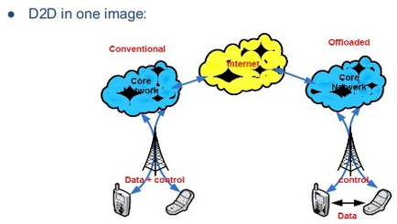
Discussion
Notes:
BER
Optical fiber: 10⁻¹¹ or 10⁻¹²
Mobile channel:
Good quality: 10⁻⁶
Actual condition: 10⁻² or worse

Slide 53
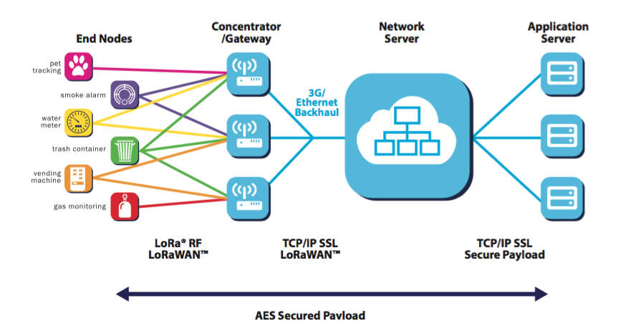
Discussion
Notes:
BER
Optical fiber: 10⁻¹¹ or 10⁻¹²
Mobile channel:
Good quality: 10⁻⁶
Actual condition: 10⁻² or worse

Slide 54
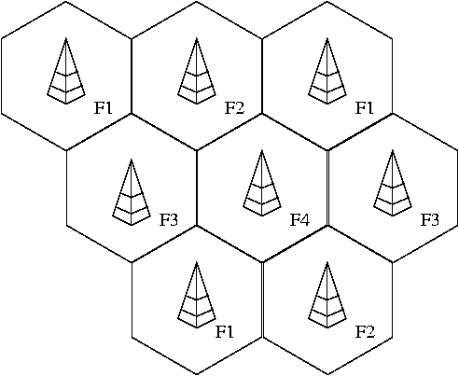
Cellular Networks
Network is divided into multiple cells, each served by a fixed base station
Image courtesy of Wikipedia

Slide 55
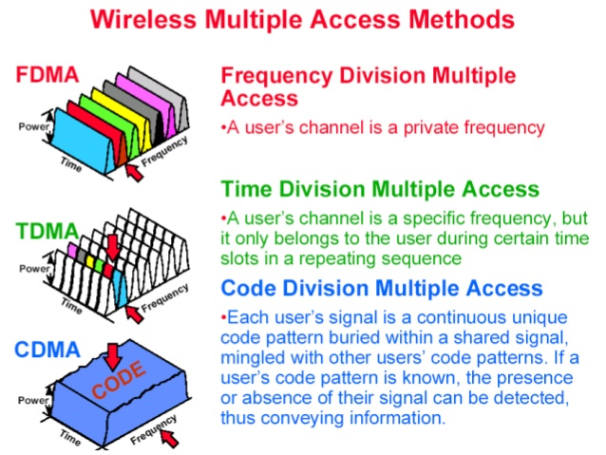

Slide 56
Broadband Wireless Networks: WiMAX
Standardized as 802.16e
Provides last-mile wireless broadband connectivity
Operates at 3.5 GHz, 2.3/2.5 GHz, or 5 GHz
Maximum data rate: ~64 Mbps
Range: ~10 km
Provides built-in Quality-of-Service (QoS) support
Uses MIMO technology with AMC
Notes:
Worldwide Interoperability for Microwave Access

Slide 57
Short-Range Wireless Networks: Bluetooth
Standardized as IEEE 802.15.1
Used to connect devices at short ranges
Operates at 2.4 GHz
Maximum data rate: 2.1 Mbps
Range: ~10m to ~100m

Slide 58
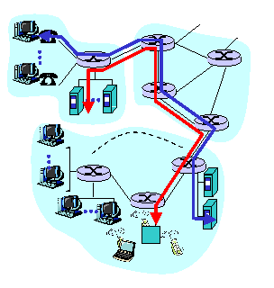
Wide Area Networks
Circuit Switching
Dedicated communication path
All packets travel through the same path
No delays occur because path is designated
No other user can use a dedicated circuit until its free
High costs incurred

Slide 59
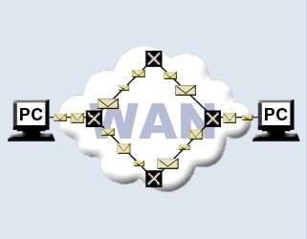
Wide Area Networks
Packet Switching
Individual packets are sent out separately from source to destination
Each packet treated as a separate message
All packets may be routed through different paths
No dedicated channel required
Low cost of implementation
Variable packet length

Slide 60
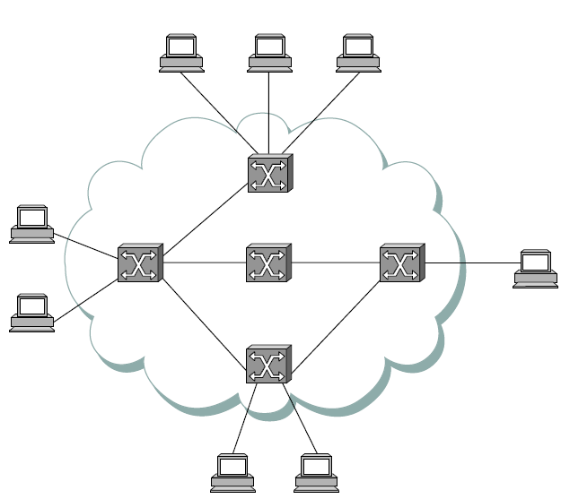
Difference between telecom and data networks
Circuit switched networks
Source
(Caller)
Call establishment
(before data transfer)
Data transfer
Connection close
Destination
(Callee)

Slide 61
Difference between telecom and data networks
Packet switched networks
Source
Destination
…
Message
…
Packets
Notes:
Difference between message and packet
‘Store and forward’ paradigm in contrast to ‘message stream’ paradigm of circuit switching.
Definition of switches and hosts.

Slide 62
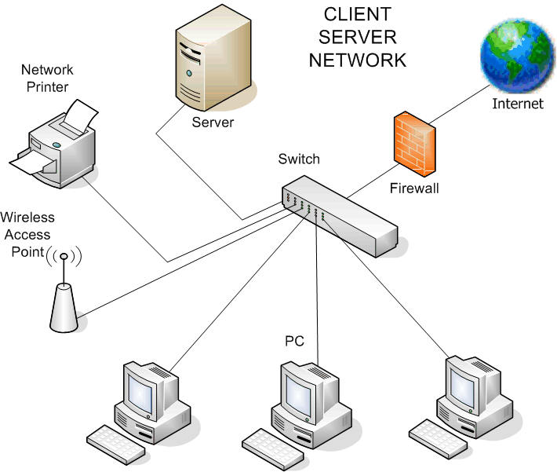
Classification
(Network Paradigm)
Client-server networks:
Examples: DNS, HTTP, DBMS servers and client
Notes:
Image source: http://www.directassist.net/Images/servic6.gif

Slide 63
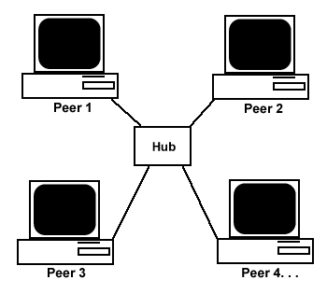
Classification
(Network Paradigm)
Peer-to-peer (P2P) networks:
Examples: Workgroup computing; P2P networks such as BitTorrent, Gnutella, Morpheus, etc.
Notes:
Image source: http://www.techsoup.org/binaries/images/peertopeer.gif

Slide 64
Classification
(Hierarchy)
Core
Distribution
Access
Notes:
Core layer: This layer is considered the backbone of the network and includes the high-end switches and high-speed cables such as fiber cables. This layer of the network does not route traffic at the LAN. In addition, no packet manipulation is done by devices in this layer. Rather, this layer is concerned with speed and ensures reliable delivery of packets. Distribution layer: This layer includes LAN-based routers and layer 3 switches. This layer ensures that packets are properly routed between subnets and VLANs in your enterprise. This layer is also called the Workgroup layer. Access layer: This layer includes hubs and switches. This layer is also called the desktop layer because it focuses on connecting client nodes, such as workstations to the network. This layer ensures that packets are delivered to end user computers.
http://www.mcmcse.com/cisco/guides/hierarchical_model.shtml

Slide 65
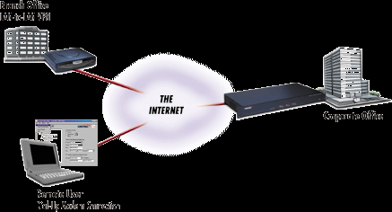
Classification
(Type)
Internet
Intranet
VPN
Extranet
Image source: http://www.flexsys-group.com
Notes:
An intranet is a private computer network that uses Internet technologies to securely share any part of an organization's information or operational systems with its employees. Sometimes the term refers only to the organization's internal website, but often it is a more extensive part of the organization's computer infrastructure and private websites are an important component and focal point of internal communication and collaboration.
An intranet is built from the same concepts and technologies used for the Internet, such as client-server computing and the Internet Protocol Suite (TCP/IP). Any of the well known Internet protocols may be found in an intranet, such as HTTP (web services), SMTP (e-mail), and FTP (file transfer). Internet technologies are often deployed to provide modern interfaces to legacy information systems hosting corporate data.
An intranet can be understood as a private version of the Internet, or as a private extension of the Internet confined to an organization. The term first appeared in print on April 19, 1995, in Digital News & Review in an article authored by technical editor Stephen Lawton.^{[1]}
Intranets differ from extranets in that the former are generally restricted to employees of the organization while extranets may also be accessed by customers, suppliers, or other approved parties.^{[2]} Extranets extend a private network onto the Internet with special provisions for access, authorization and authentication (see also AAA protocol).

Slide 66
Access technology
(Narrowband)
Uses analog telephone lines
Utilizes a modulator/ demodulator (Modem)
Modems perform error correction/ compression
V.34 (28.8, 33.6 kbps); V.90 and V.92 (56 kbps)
Telephone networks limit a single narrowband channel to 56 kbps

Slide 67
Access technology
(Broadband)
Leased Circuits: E1 (2M), E2 (8M), E3 (34M)
DSL: Utilizes telephone lines but performs efficient digital coding
Types: HDSL, SDSL, VDSL
Cable: Utilizes co-axial cables and provides similar access speeds to DSL
WiMax: Wireless broadband technology
Notes:
DSL: DSL (VDSL) typically works by dividing the frequencies used in a single phone line into two primary "bands". The ISP data is carried over the high-frequency band (25 kHz and above) whereas the voice is carried over the lower-frequency band (4 kHz and below).
Digital subscriber line technology was originally implemented as part of the ISDN specification, which is later reused as IDSL. Higher speed DSL connections like HDSL and SDSL have been developed to extend the range of DS1 services on copper lines. Consumer oriented ADSL is designed to operate also on a BRI ISDN line, which itself is another (not IP) form of digital signal transmission, as well as on an analog phone line.
Using ADSL, up to 6.1 megabits per second of data can be sent downstream and up to 640 Kbps upstream.
G.Lite or DSL Lite
G.Lite (also known as DSL Lite, splitterless ADSL, and Universal ADSL) is essentially a slower ADSL that doesn't require splitting of the line at the user end but manages to split it for the user remotely at the telephone company. This saves the cost of what the phone companies call "the truck roll." G.Lite, officially ITU-T standard G-992.2, provides a data rate from 1.544 Mbps to 6 Mpbs downstream and from 128 Kbps to 384 Kbps upstream. G.Lite is expected to become the most widely installed form of DSL.
HDSL
HDSL (High bit-rate Digital Subscriber Line), one of the earliest forms of DSL, is used for wideband digital transmission within a corporate site and between the telephone company and a customer. The main characteristic of HDSL is that it is symmetrical: an equal amount of bandwidth is available in both directions. HDSL can carry as much on a single wire of twisted-pair cable as can be carried on a T1 line (up to 1.544 Mbps) in North America or an E1 line (up to 2.048 Mbps) in Europe over a somewhat longer range and is considered an alternative to a T1 or E1 connection.
SDSL
SDSL (Symmetric DSL) is similar to HDSL with a single twisted-pair line, carrying 1.544 Mbps (U.S. and Canada) or 2.048 Mbps (Europe) each direction on a duplex line. It's symmetric because the data rate is the same in both directions.
VDSL
VDSL supports upto 51 Mbps

Slide 68
Some Standardization Bodies
IEEE
IEFT – Internet Engineering Task Force
3GPP/3GPP2 – 3rd Gen Partnership Project
ITU – International Telecommunication Union

Slide 69
Guided Transmission Media
Magnetic media
Twisted pairs
Coaxial cable
Power lines
Fiber optics

Slide 70
Magnetic Media
Write data onto magnetic media
Disks
Tapes
Data transmission speed
Never underestimate the bandwidth of a station wagon full of tapes hurtling down the highway.

Slide 71
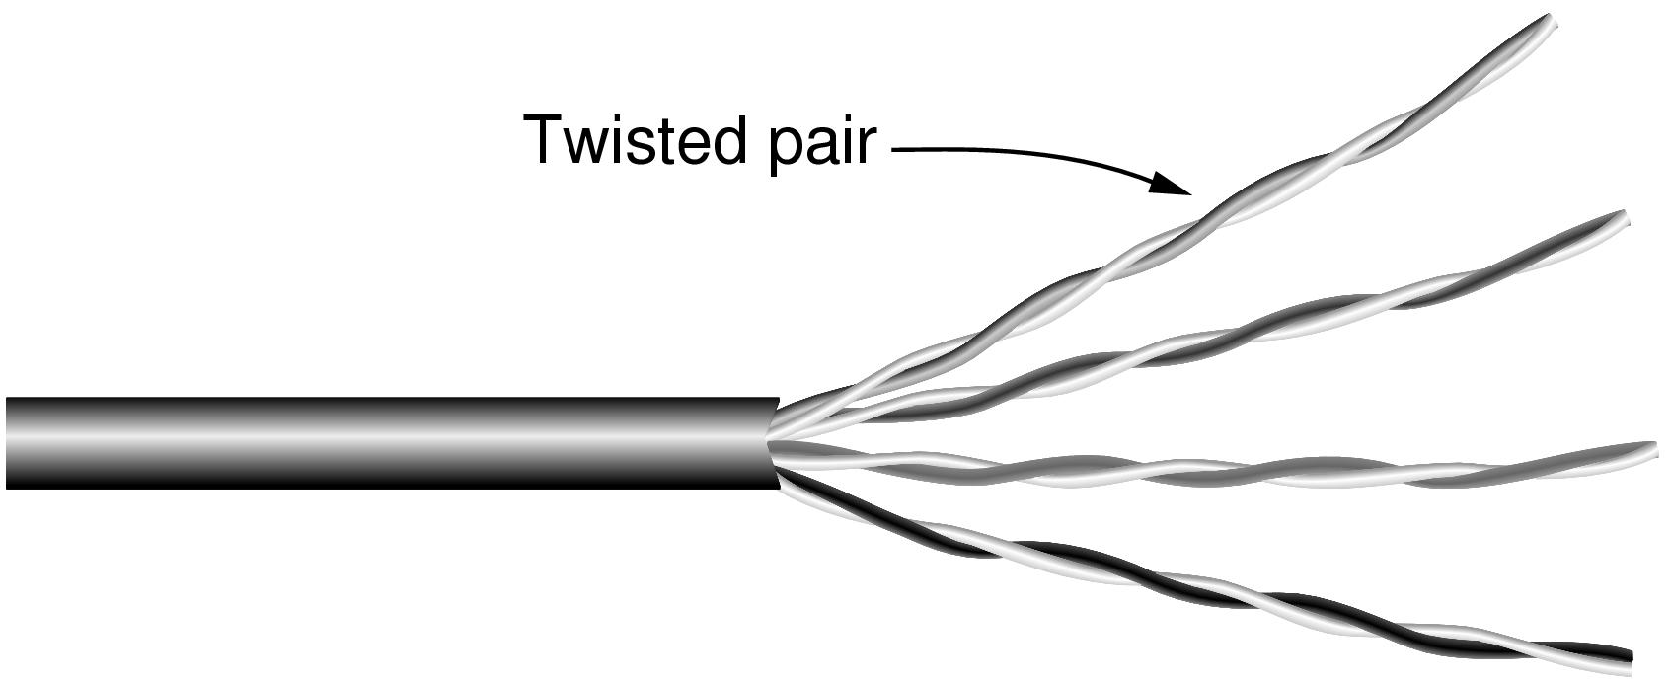
Twisted Pairs
Category 5 UTP cable with four twisted pairs

Slide 72
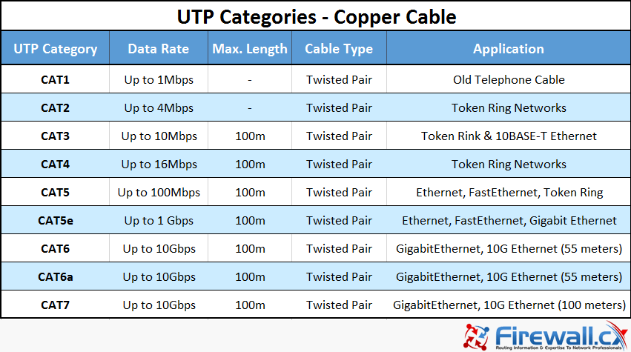
Twisted Pairs

Slide 73
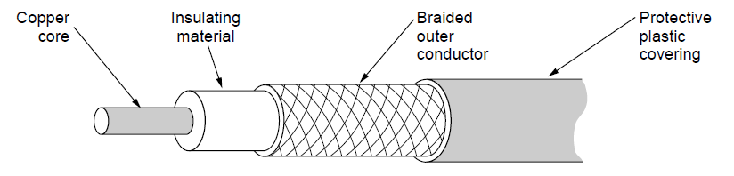
Coaxial Cable
A coaxial cable

Slide 74
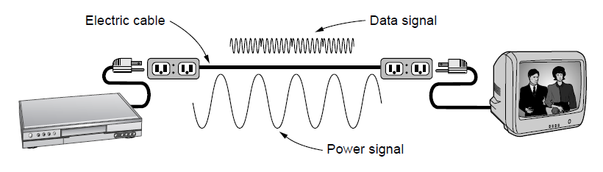
Power Lines
A network that uses household electrical wiring.

Slide 75
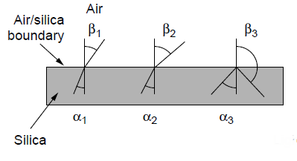
Fiber Optics
Three examples of a light ray from inside a silica fiber impinging on the air/silica boundary at different angles.

Slide 76
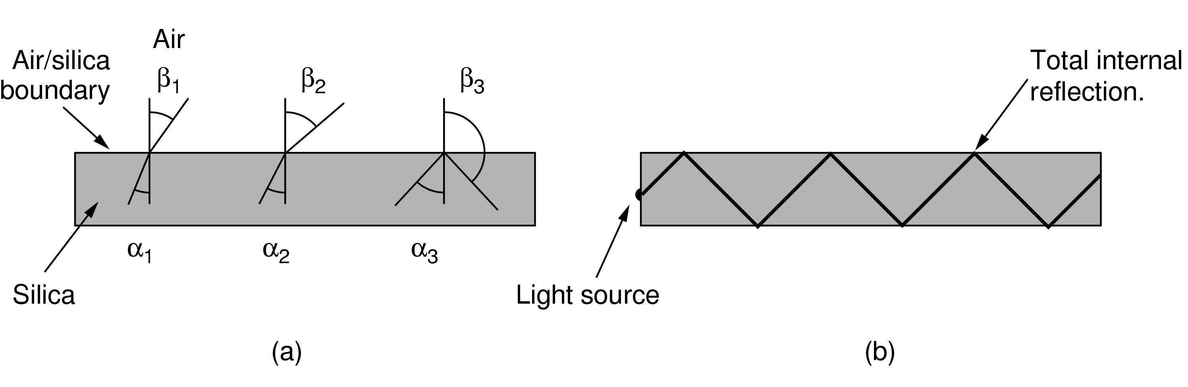
Fiber Optics
Light trapped by total internal reflection.

Slide 77
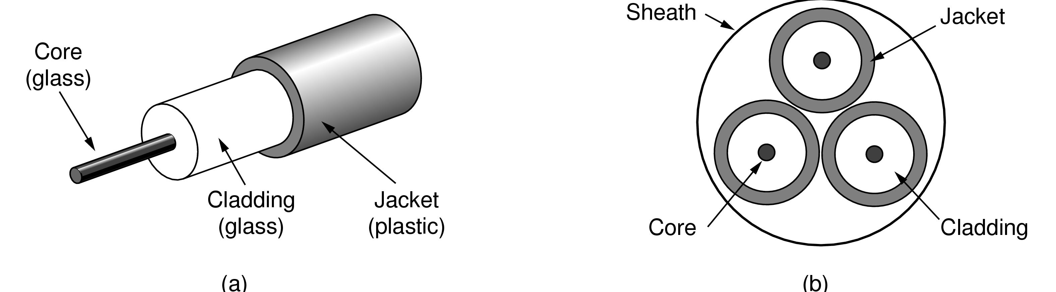
Fiber Cables
Views of a fiber cable

Slide 78
Recap of Network lectures
Media (wired and wireless);
Topology (bus, star, mesh, ring, tree);
Protocol (HTTP, TCP/IP, MAC);
Addressing (IP, MAC);
Naming (domain, hostnames);
Layered Communication (TCP/IP model);
Networking devices (hubs, switches, routers);
Routing and Internetworking;

Slide 79
?
?
?
Questions/ Confusions?
Quote of the week
When fear knocks, let faith answer the door
Robin Roberts

